Slide 1
Agile Methodologies
Software Engineering
Neil Toporski

Slide 2
2. Methodologies [Outline]
Overview
The Waterfall Model
Incremental Development
Comparing Incremental to Waterfall

Slide 3
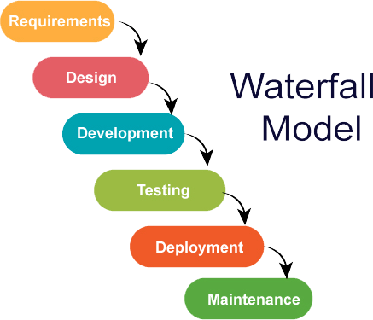
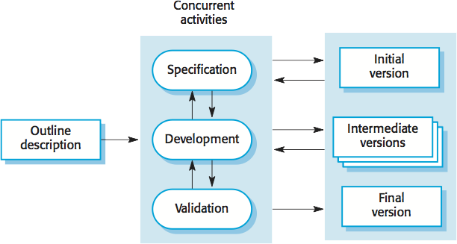
2.1 Methodologies
Incremental Development
Notes:
Waterfall – one process at a time
Agile – increments and improving on it (requirements can change as we build)

Slide 4
2.2 The Waterfall Model
One step follows the previous step.
The following phase should not start until the previous phase has finished.
Works well with small, uncomplicated projects.
*However, in software development, these stages tend to overlap and feed information to each other.

Slide 5

Problems with the Waterfall Model
The main problem with the Waterfall model is difficulty accommodating change after the process begins. Ideally, each phase should be complete before moving to the next.
Not suitable for situations where software requirements change quickly.
Notes:
Lose time and money

Slide 6
Problems with the Waterfall Model
New Home Example
Architect and customer plan home blueprint and specs (requirements and design)
Construction begins. (development) Problems found with easement or city building codes. (-> back to 1)
Construction begins again. Customer notices changes or has issues with expected home layout or materials (-> back to 1 to 3) Increased time and expense to customer.
Oops! Customer wants to make major changes!
Construction ends. Inspection (testing) finds multiple electric “violations” (i.e not enough outlets per room). (-> back to 1 to 3)
Violations corrected. Another increase in time and expense to customer.
Customer moves in 1 year late and notices finishes not quite what was expected. Customer now infuriated!
Notes:
Contingency +10-20%

Slide 7
2.3 Incremental Development
Based on the idea of developing an initial implementation, getting feedback from users and others evolving the software through several versions until the final system has been developed.

Slide 8
Incremental Compared to Waterfall
Benefits
Reduced costs when client requirements change.
Increased client communications and feedback.
Rapid development and deployment of “potentially shippable product”.
Disadvantages
The process should always be transparent. Documentation may not reflect versions of the developed systems.
System structure may degrade as new increments added. Software changes during the process may become difficult and costly.

Slide 9
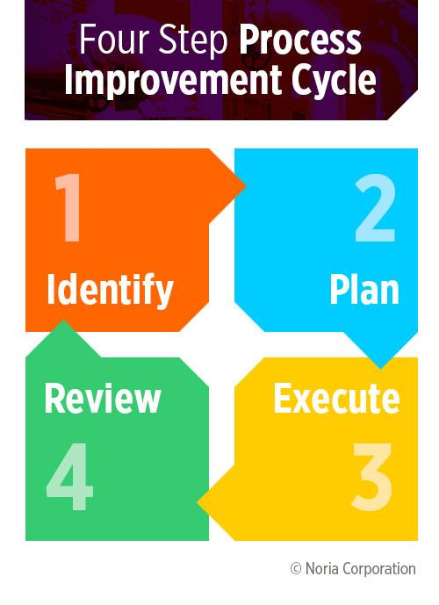
3.8 Process Improvement
Understanding existing processes and changing these processes to increase product quality, reduce costs, or reduce development time.
Process maturity approach: Improve product quality and predictability.
Agile approach: An iterative approach for rapid delivery of functionality and responsiveness to client requirements.

